Slide 1
Lecture Notes:
Pixelization, Quantization, and Steganography

Slide 2
Pixelization

Slide 3
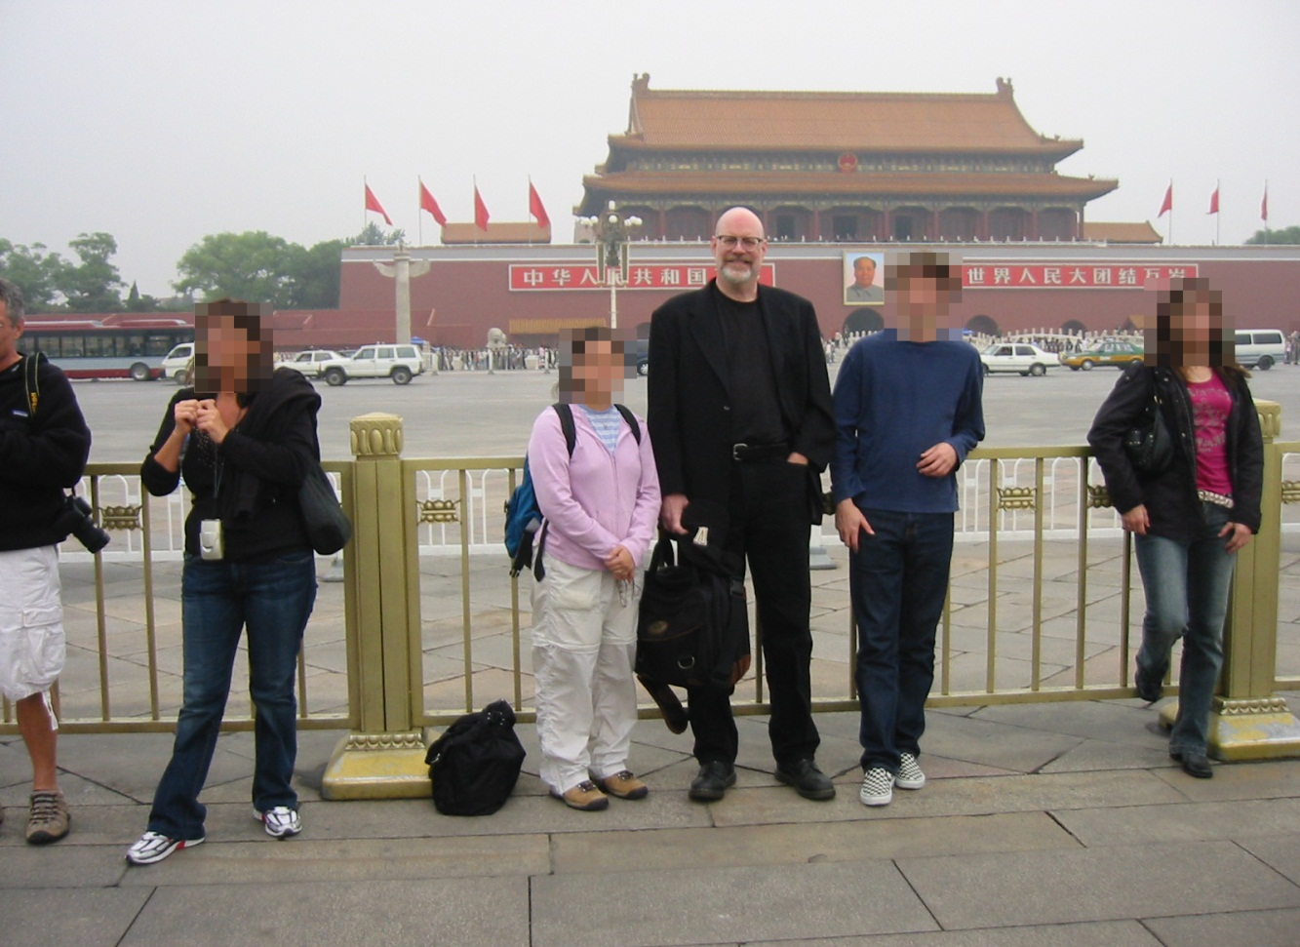
Pixelization …
… is a special effect often used to hide identities …

Slide 4

Pixelization
… or to “clean up” an image.

Slide 5

Pixelization and Quantization
high-res image
pixelated
quantized
pixelated
& quantized
This is what a digital camera does to the continuous tone image projected by its optics onto the sensor plane.

Slide 6
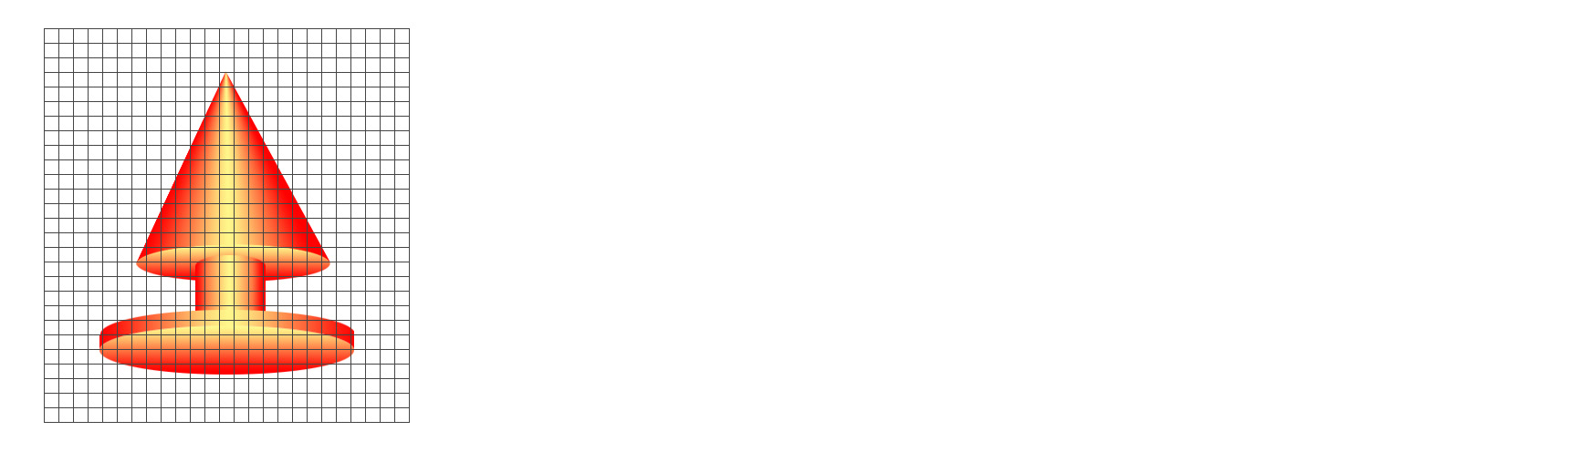
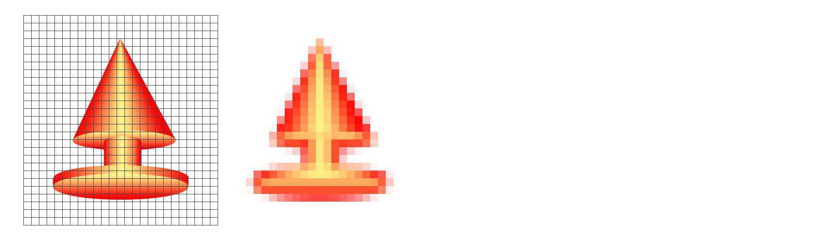
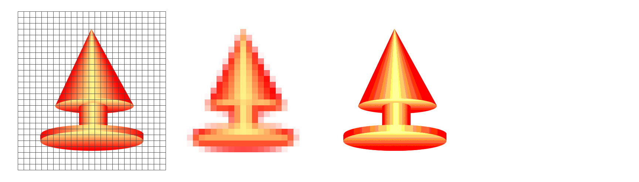
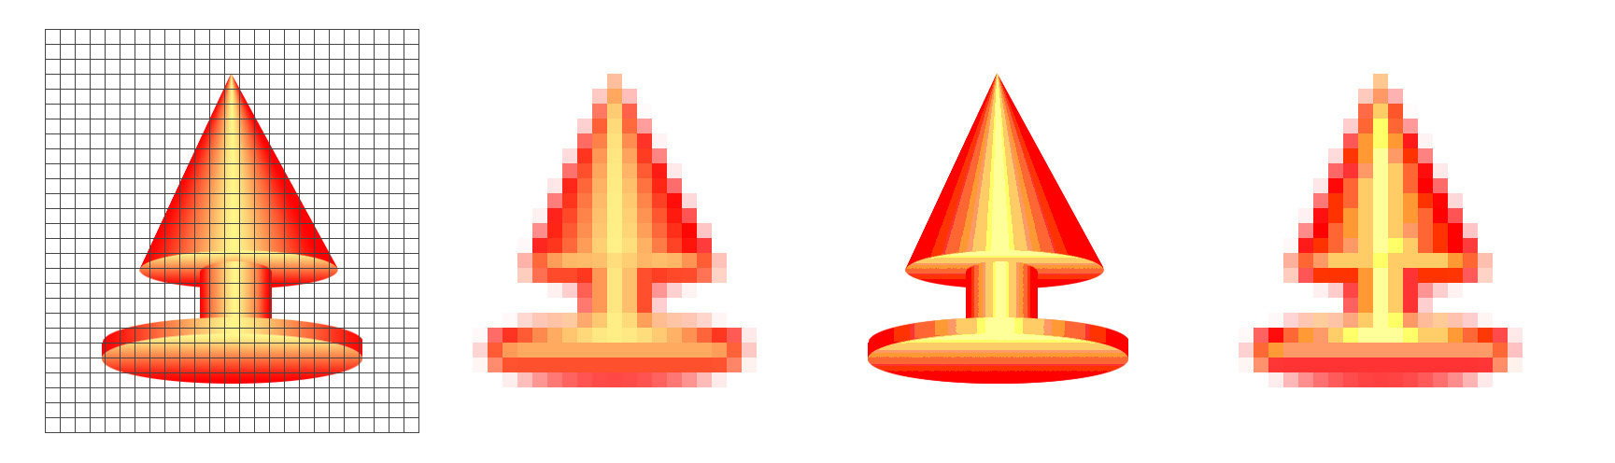
Pixelization and Quantization
pixel grid
column index
row index
high-res image
pixelated
quantized
pixelated
& quantized
All the photons that hit a single sensor combine to produce a single intensity. The result is pixelization of the image.
The intensity values are quantized – mapped to a limited range of numbers.

Slide 7
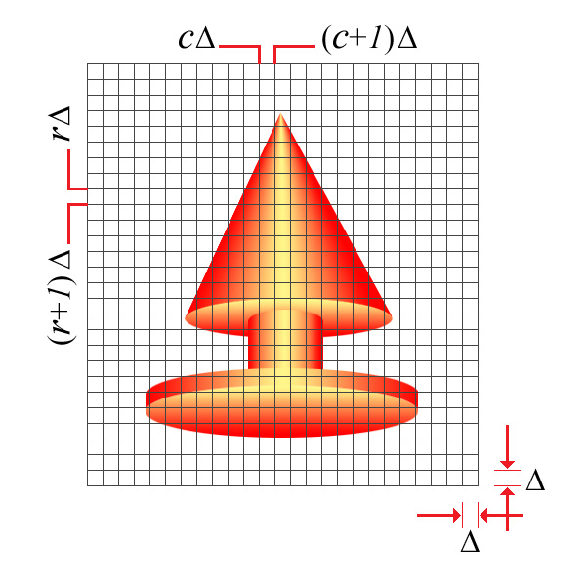
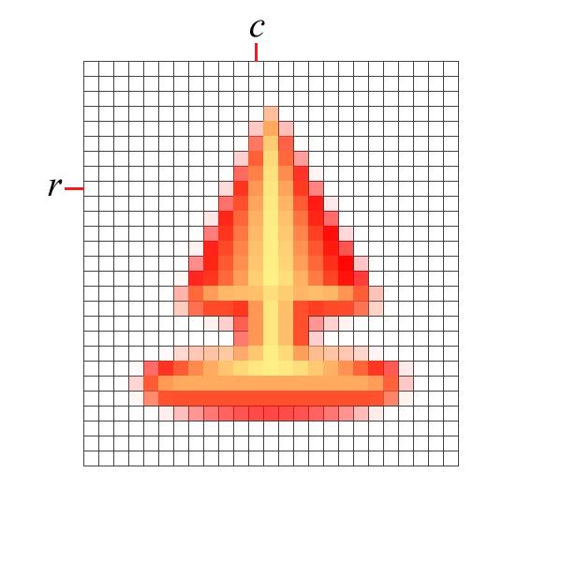
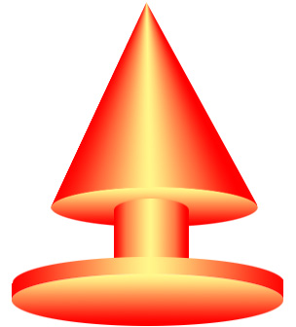

Pixelization
Take the average within each square.
high-res image
pixelated image
(upsampled)
(upsampled)

Slide 8
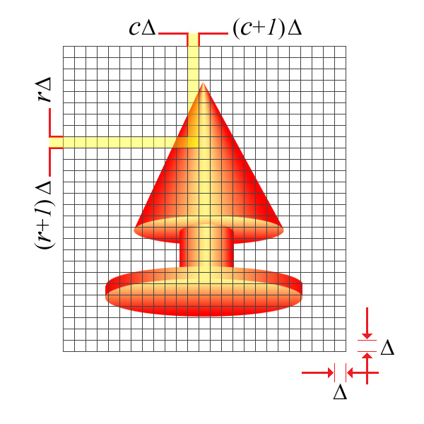
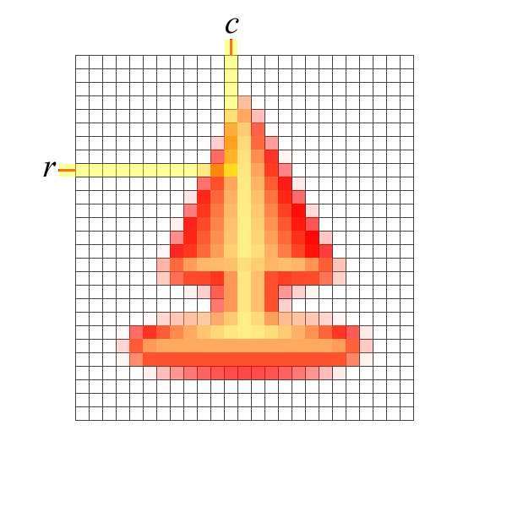
Pixelization
Take the average within each square.
high-res image
pixelated image
(upsampled)
(upsampled)

Slide 9
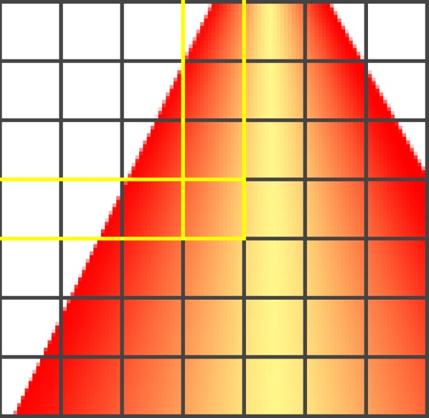
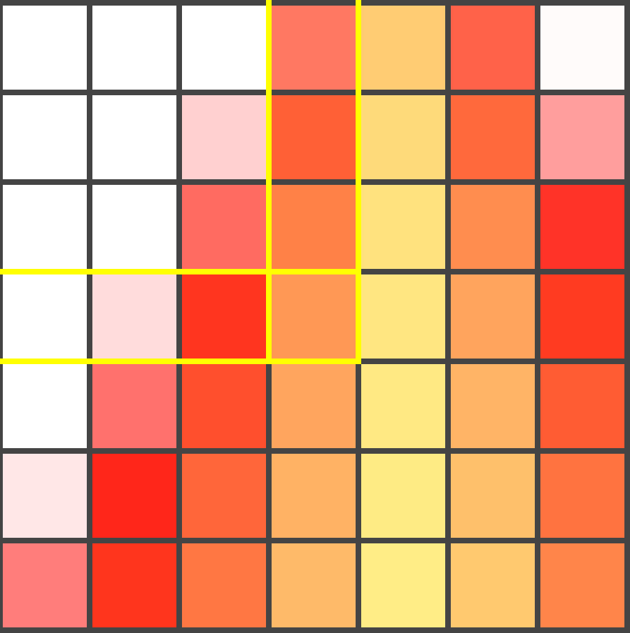
Pixelization
Take the average within each square.
high-res image
pixelated image
(upsampled)
(upsampled)

Slide 10
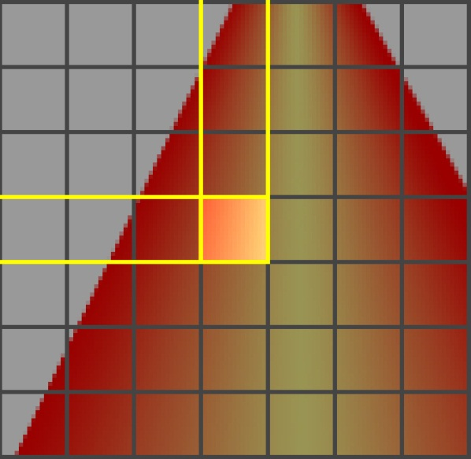
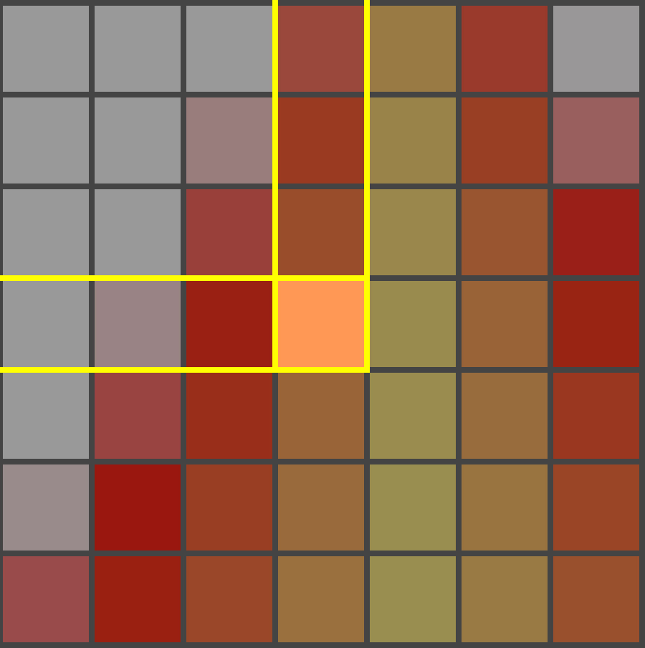
Pixelization
Take the average within each square.
high-res image
pixelated image
(upsampled)
(upsampled)

Slide 11
Pixelization Procedure (Part 1)
To pixelize an R×C×B image I by a factor, s:
Let I↓ be an ⎣R/s⎦×⎣C/s⎦×B image.
Let the value of I↓ at location (r,c,b) be the average value of I in the s-square neighborhood starting at (rs,cs,b).
where
Notation:
I_{DS} = I ↓ s
I_{DS} is I downsampled by a factor of s.
r & c are indices in the downsampled image.
ρ=rs+i & χ=cs+j are indices in the original image.

Slide 12
Pixelization Procedure (Part 2)
Let I_{P} be an R×C×B image.
Let the value of I_{P} in neighborhood, N(r,c) be I_{DS}(r,c).
where
Notation:
I_{P} = I_{DS}↑ s
I_{P} is I_{DS} upsampled by a factor of s.
r & c are indices in the downsampled image.
ρ=rs+i & χ=cs+j are indices in the upsampled image.

Slide 13

Pixelization
8 of 8: 256x256
What is the scene in this picture?

Slide 14

Pixelization
7 of 8: 128x128
What is the scene in this picture? A room with a window?

Slide 15

Pixelization
6 of 8: 64x64
What is the scene in this picture? Earth and sky?

Slide 16
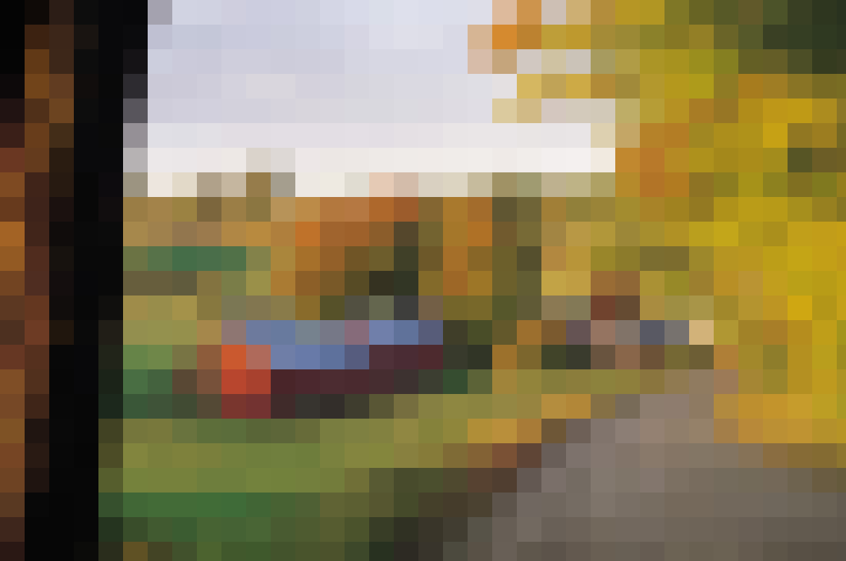
Pixelization
5 of 8: 32x32
What is the scene in this picture? A sign pointing []at a bright spot?

Slide 17
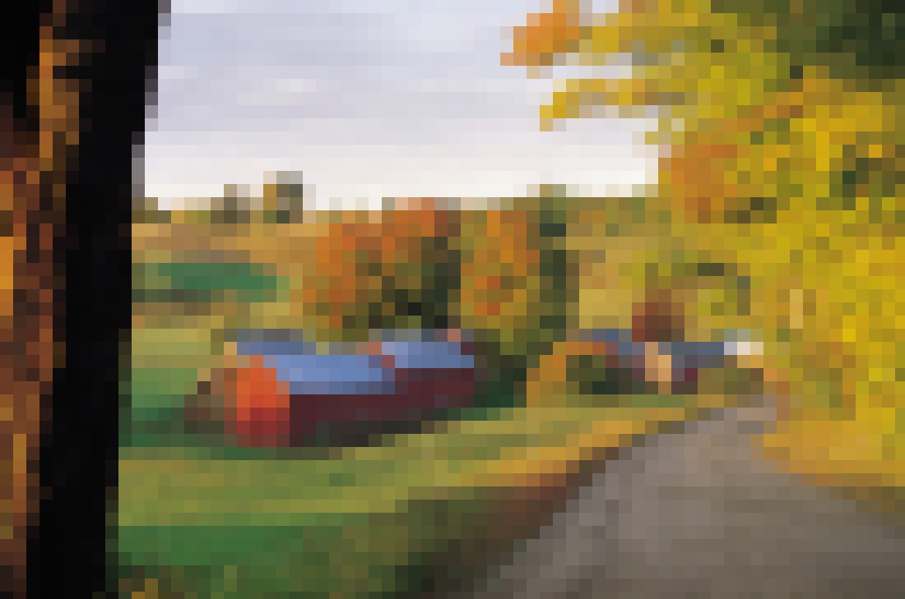
Pixelization
4 of 8: 16x16
What is the scene in this picture? A bucolic landscape with a barn?

Slide 18
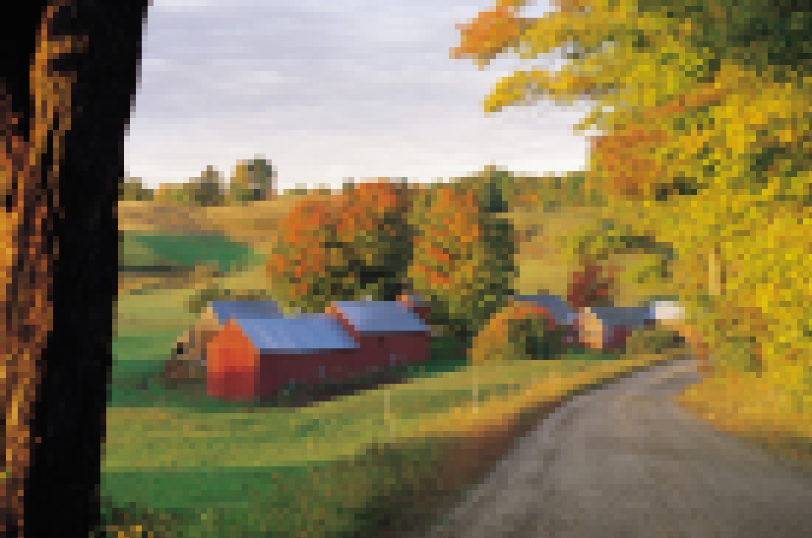
Pixelization
3 of 8: 8x8
A bucolic landscape with a barn? Yes and a fine autumn day, too.

Slide 19
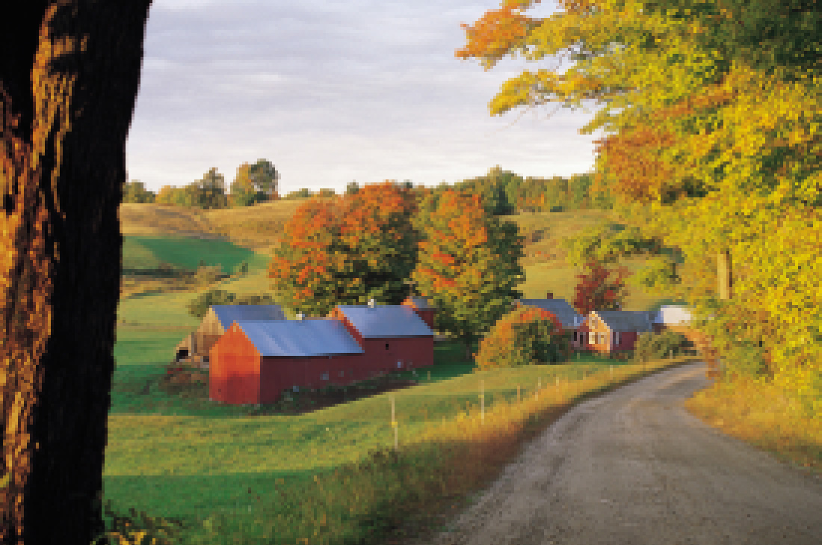
Pixelization
2 of 8: 4x4
Pixels are still visible at 4×4.

Slide 20

Pixelization
1 of 8: 2x2
Pixels are pretty much invisible at 2×2. But the resolution is wanting.

Slide 21

Pixelization
original image
Switch back and forth between this slide and the previous one to see.

Slide 22

Pixelization by Factor 32
Cross-fade 1/5
This 5-step cross-fade between the original and …

Slide 23
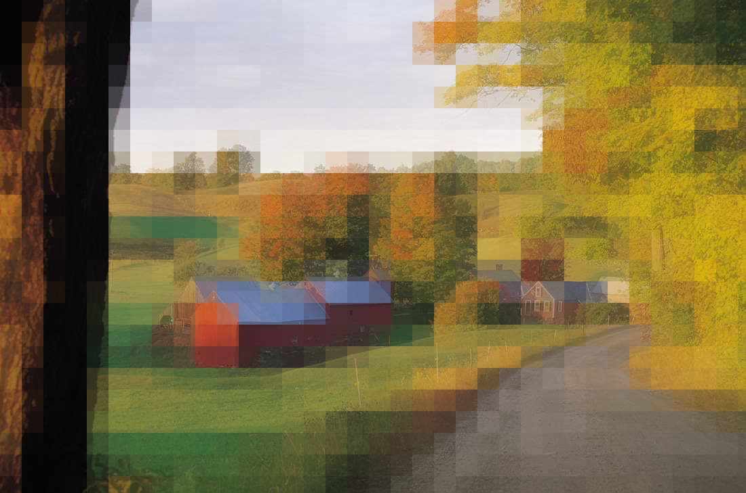
Pixelization by Factor 32
Cross-fade 2/5
… a 32×32 pixelization shows…

Slide 24

Pixelization by Factor 32
Cross-fade 3/5
… the averaging of …

Slide 25

Pixelization by Factor 32
Cross-fade 4/5
… the underlying pixels.

Slide 26
Pixelization by Factor 32
Cross-fade 5/5
Completed crossfade to a 32×32 pixelization.

Slide 27
Pixelization by Factor 32
original image
Switch back and forth between this slide and the previous one to see.

Slide 28
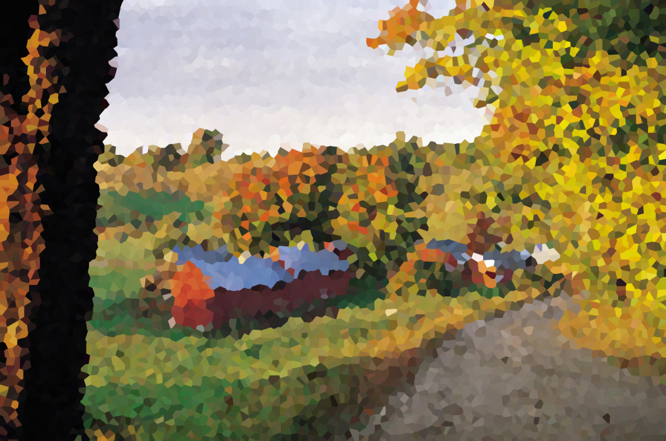
Other kinds of pixelization
photoshop “facet”

Slide 29
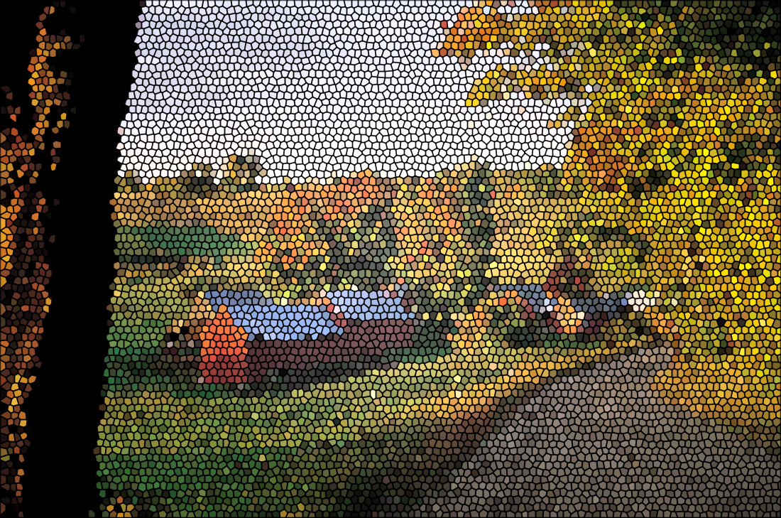
Other kinds of pixelization
photoshop “stained glass”

Slide 30
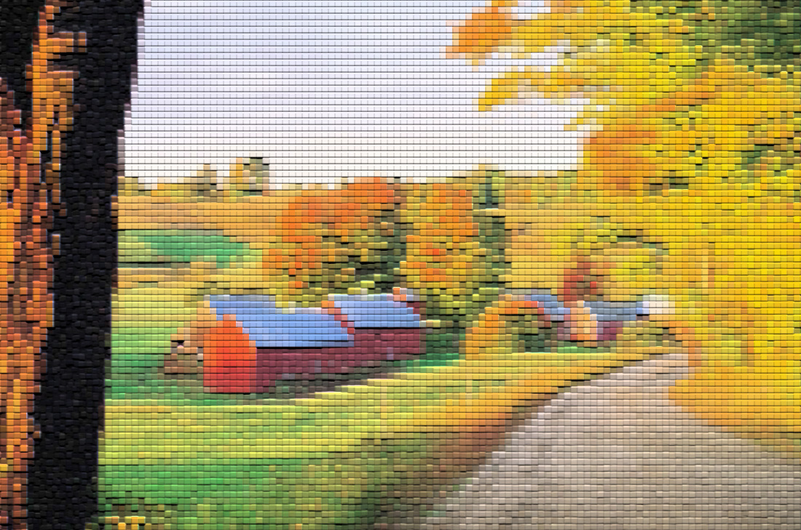
Other kinds of pixelization
photoshop “patchwork”

Slide 31
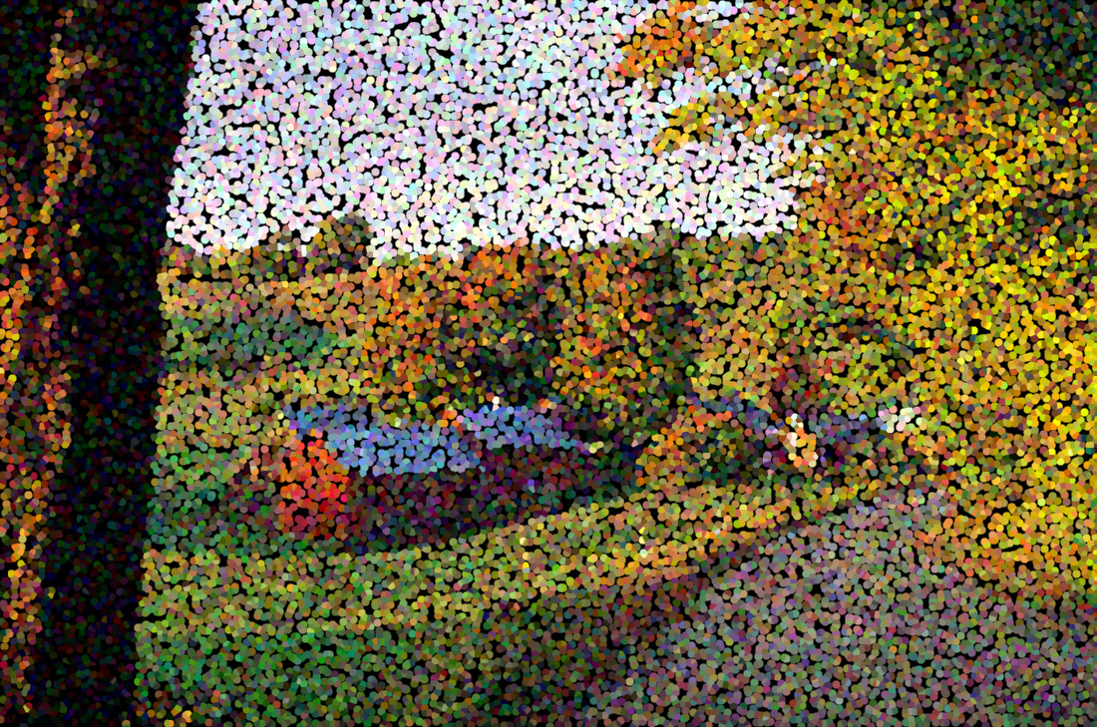
Other kinds of pixelization
photoshop “pointilized”

Slide 32
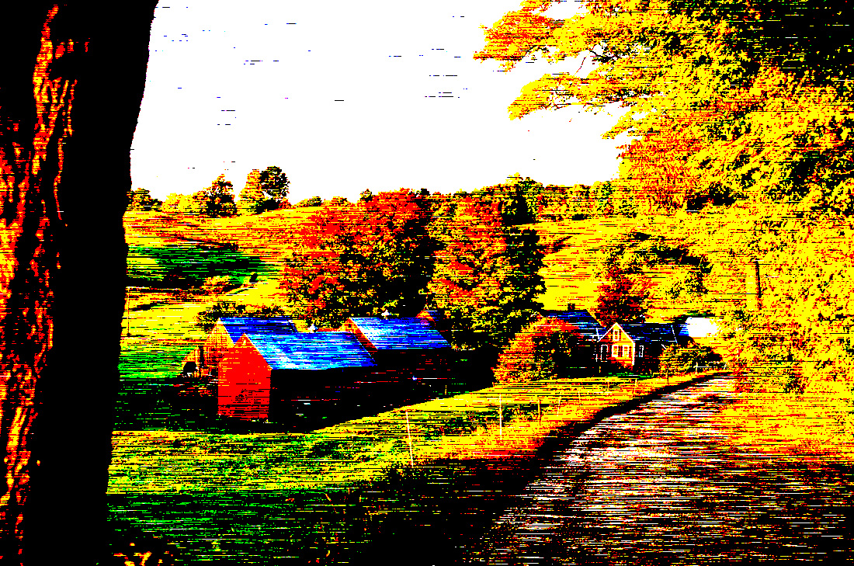
Other kinds of pixelization
photoshop “mezotint”

Slide 33
Quantization

Slide 34
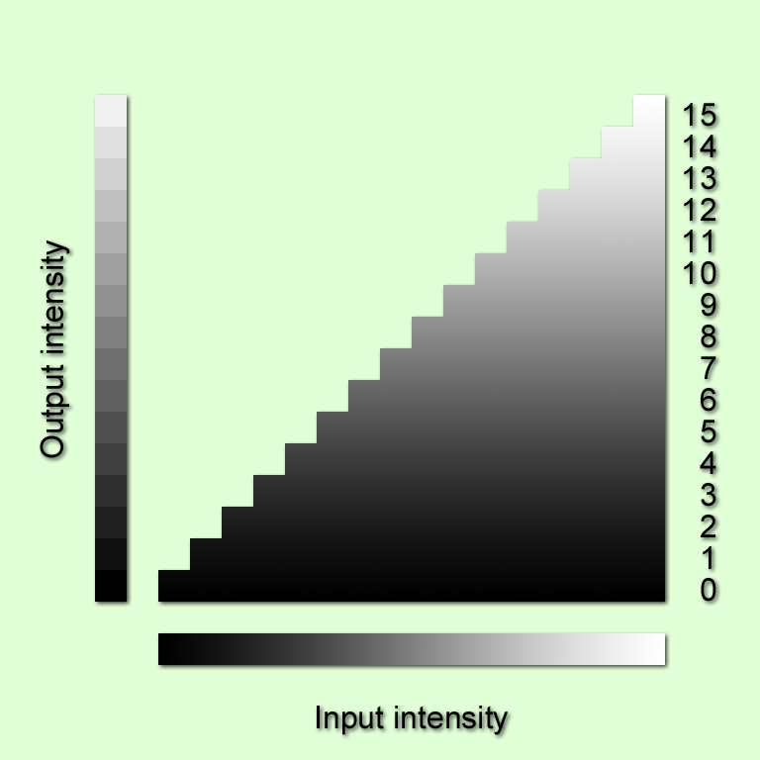


Quantization
16 million colors
16 colors

Slide 35







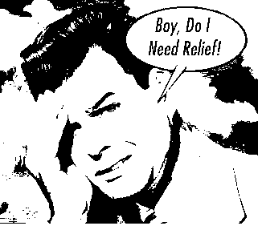
Quantization
8 bits 256 levels
7 bits 128 levels
6 bits 64 levels
5 bits 32 levels
4 bits 16 levels
3 bits 8 levels
2 bits 4 levels
1 bit 2 levels

Slide 36
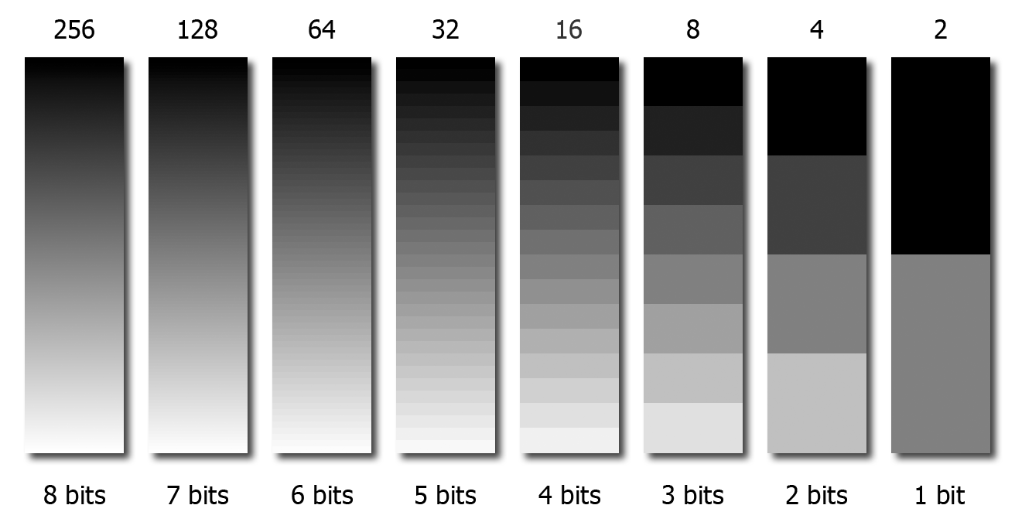
Intensity Quantization

Slide 37
Intensity Quantization
Usually with 2-bit quantization, the output intensities are mapped to {0,85,170,255},
and with with 1-bit quantization, the output intensities are taken to be {0,255}.

Slide 38
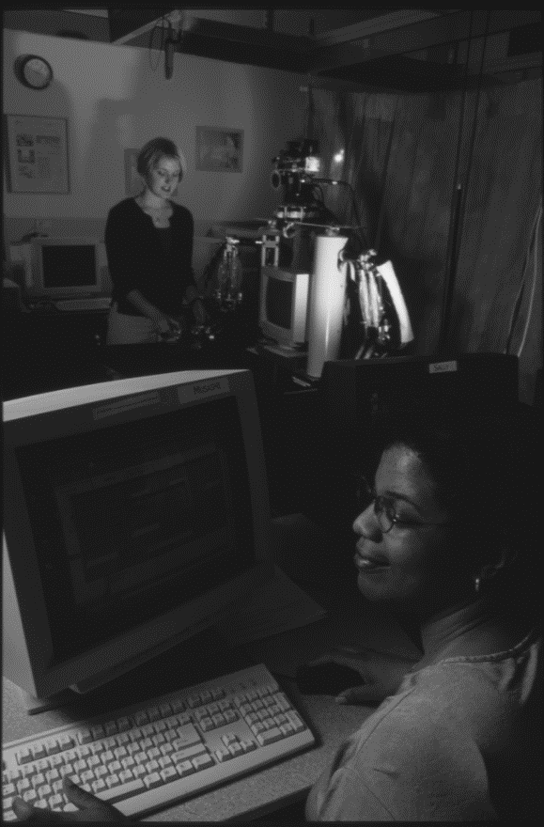
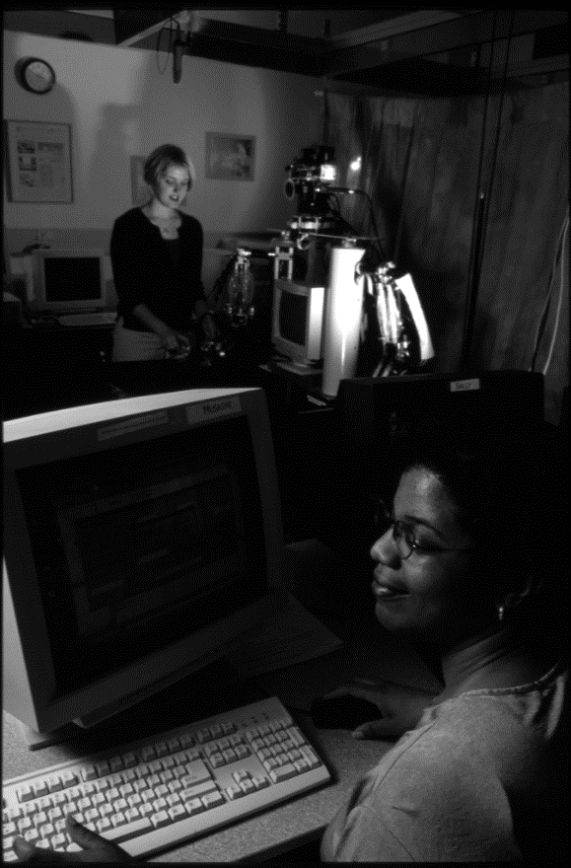
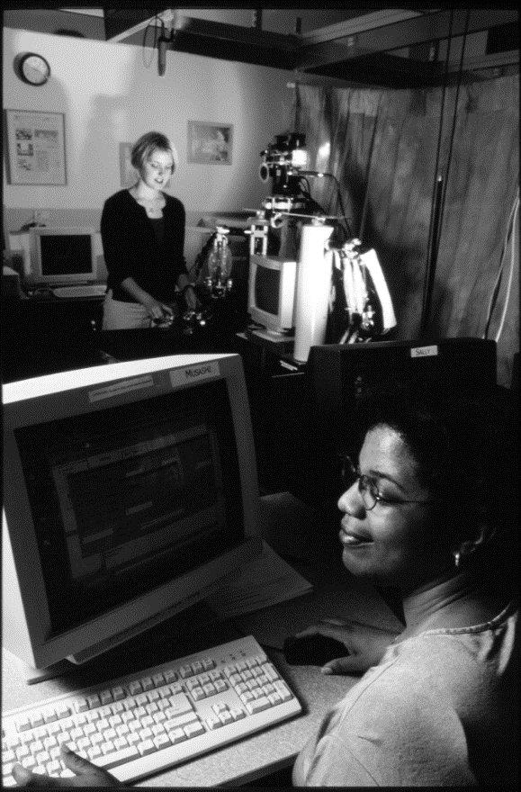
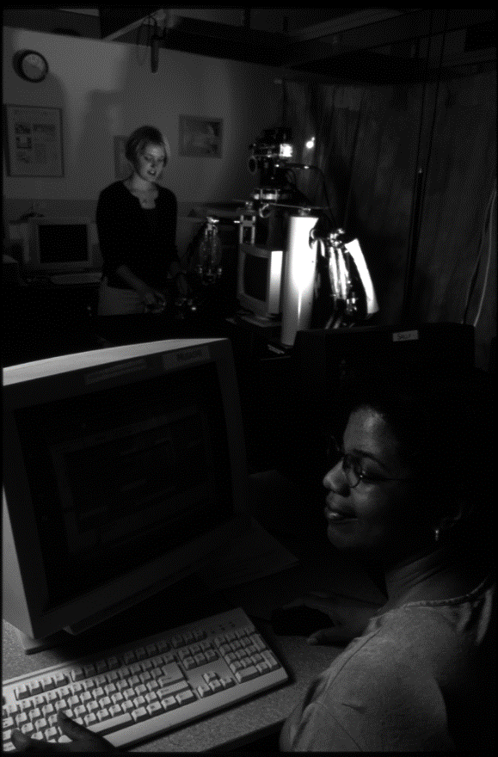
Enhancement of an 8-bit image
a. original
b. contrast enh.
b. dark enhanced
b. bright enh.

Slide 39



Enhancement of a 16-bit image
a. original
b. contrast enh.
b. dark enhanced
b. bright enh.

Slide 40
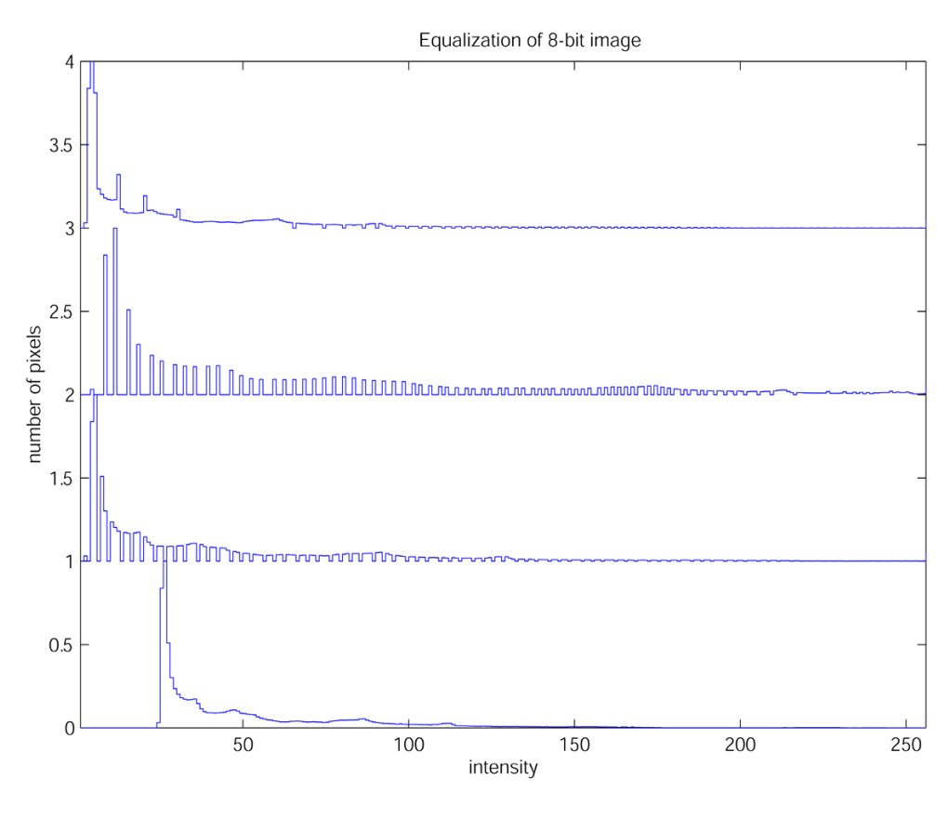
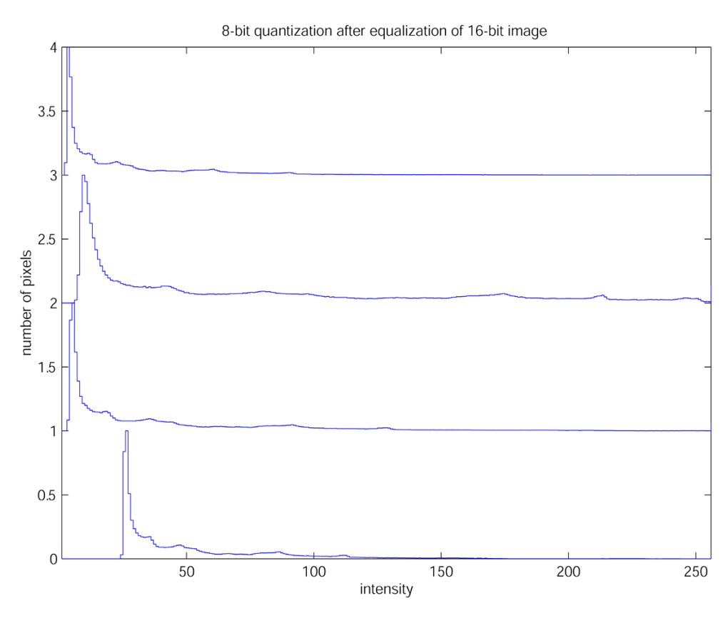
Effect of Quantization on Equalization
d. bright enh.
d. bright enh.
c. dark enh.
c. dark enh.
b. contrast enh.
b. contrast enh.
a. original
a. original

Slide 41

Effect of Quantization on Equalization

Slide 42
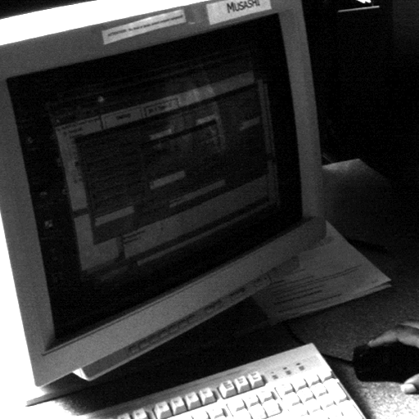

Effect of Quantization on Equalization
enhanced 8-bit
enhanced 16-bit

Slide 43
Effect of Quantization on Equalization
enhanced 16-bit
enhanced 8-bit

Slide 44
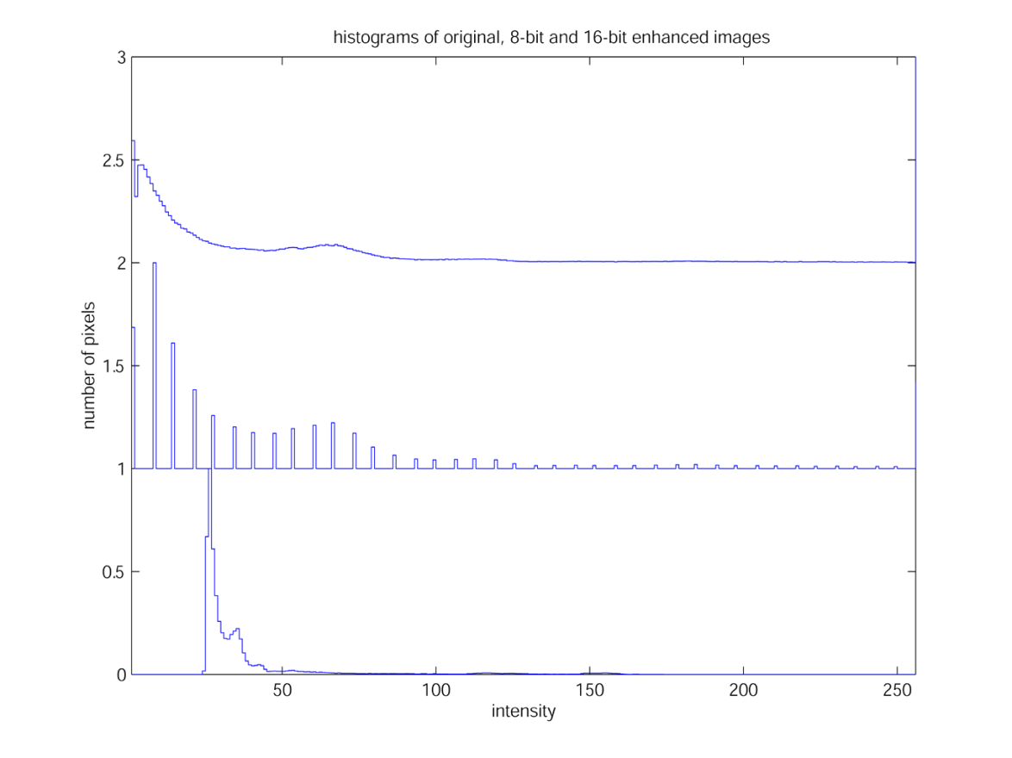
Effect of Quantization on Equalization
16-bit enhanced
8-bit enhanced
original

Slide 45
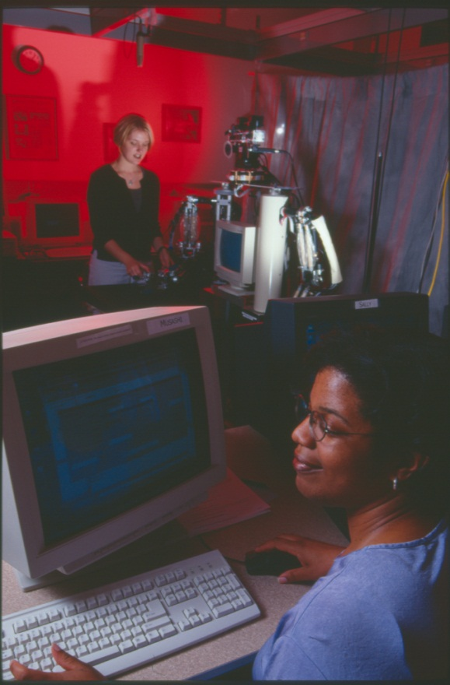

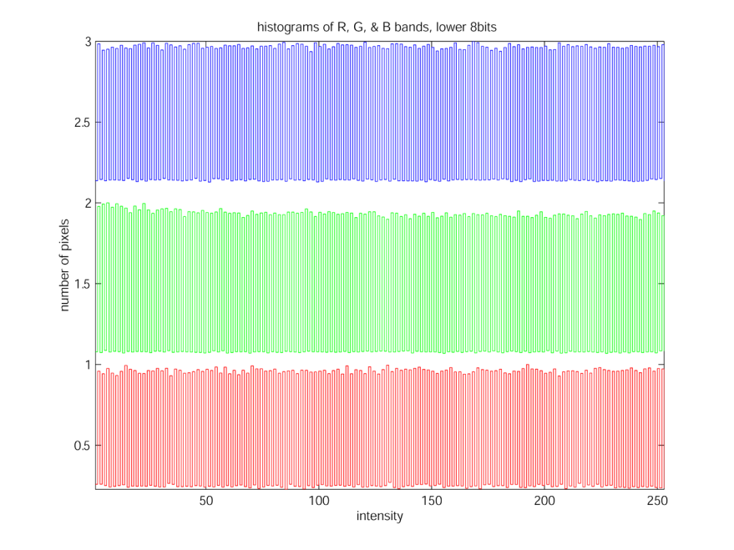
What’s in the lower eight bits?

Slide 46
Use of 16-bit images as intermediates.
When performing operations on an image that will change intensity levels, either locally or globally, sometimes better results can be had by converting the image into a 16-bit format, performing the operations, and then converting it back.
This happens frequently (and sometimes automatically) in Matlab except that each value is converted to 64-bit floating point. So this applies to other IP programs like Photoshop or gimp.
Workflow:
image 8-bpp
convert to 16-bpp
image operation
yes
?
more operations?
no
convert to 8-bpp
image out

Slide 47

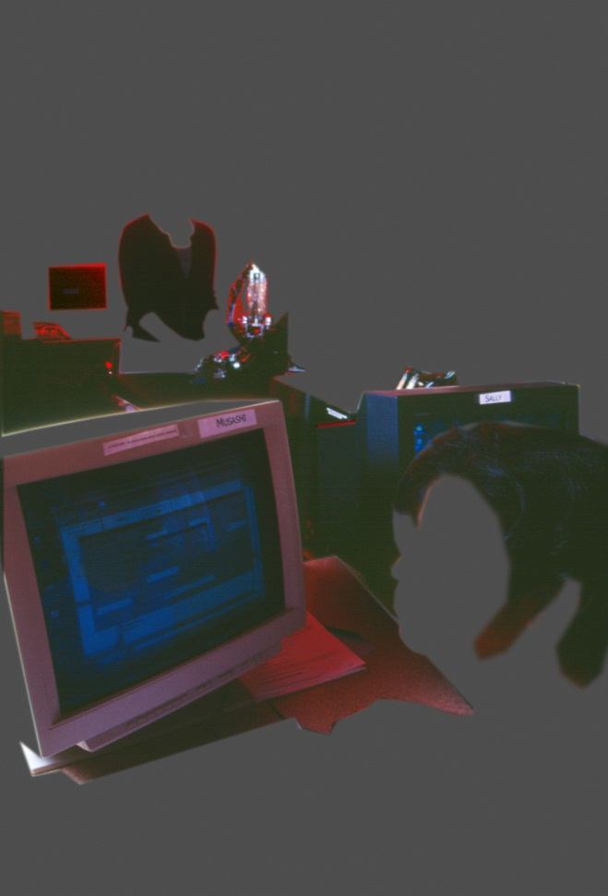
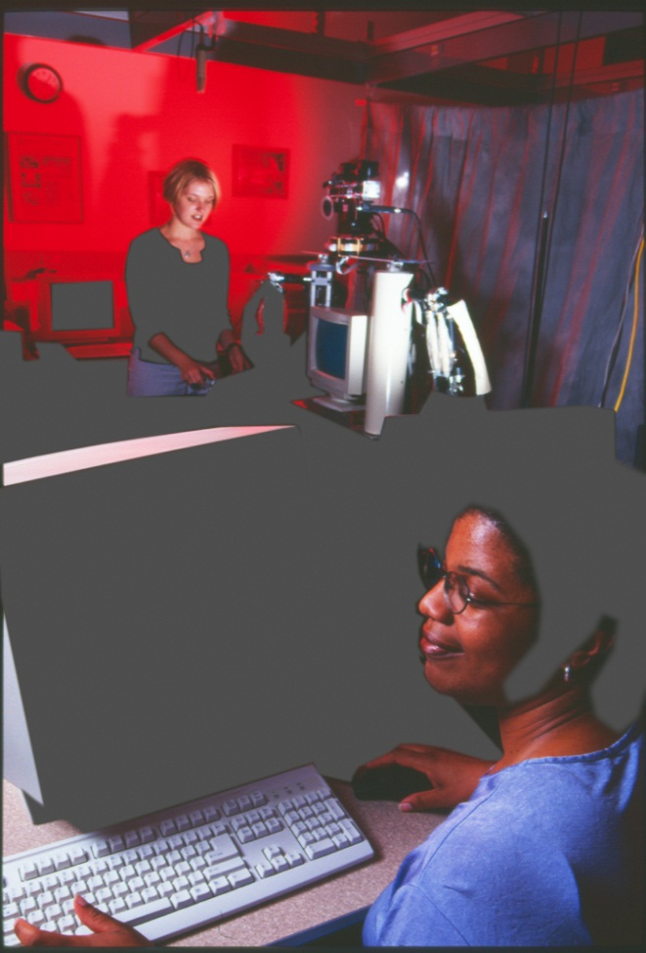
Separate EQ of Dark and Light Regions in 16-bit Images
This is a crude form of HDR imaging…
original 16-bit image
contr. stretched dark reg.
contr. stretched light reg.

Slide 48
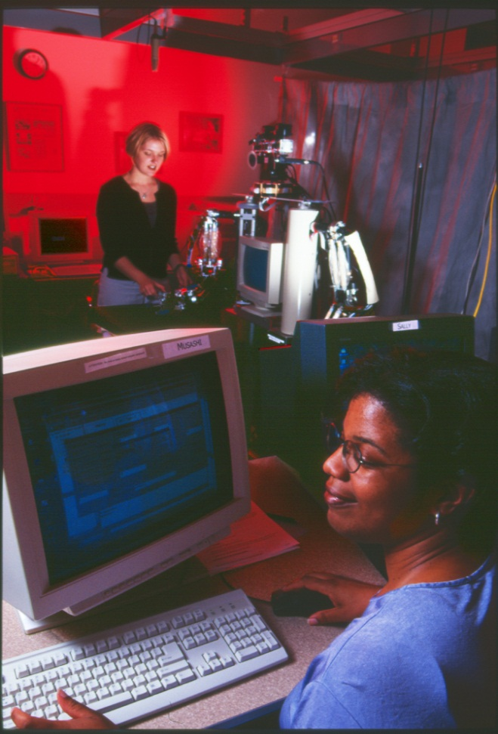
Separate EQ of Dark and Light Regions in 16-bit Images
… which is covered in a later lecture.
original 16-bit image
contr. stretched light + dark reg.

Slide 49
Dithering: Noise Improves Quantization
Quantizing an image into 1, 2, or 3 bits can introduce false contours.
The addition of signed noise to the image before quantization can improve the appearance of the result. This is called dithering.
The noise usually should have μ = 0.
The σ of the noise must be determined through experimentation since it depends on the image being quantized. A reasonable first choice for uniformally distributed noise in the interval (-,) is σ =  M/q, where M is the maximum intensity value in the image (e.g. 255) and q is the number of bits in the quantized image.
I
U(μ,σ)
Quant(q)
J
+

Slide 50
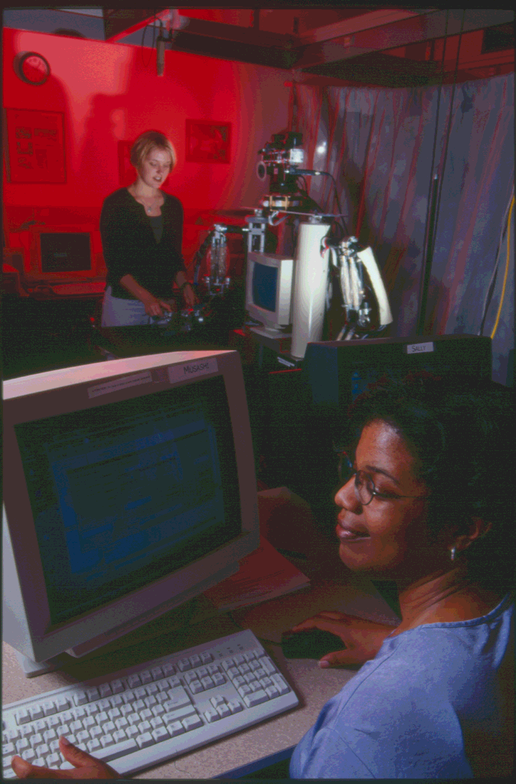
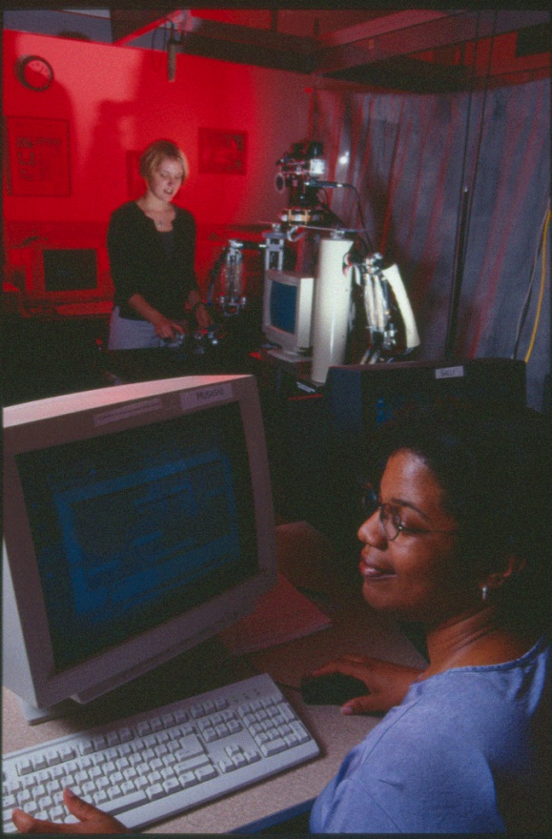
Dithering: use noise to reduce quant. error
8 bits
4 bits
4 bits + noise

Slide 51

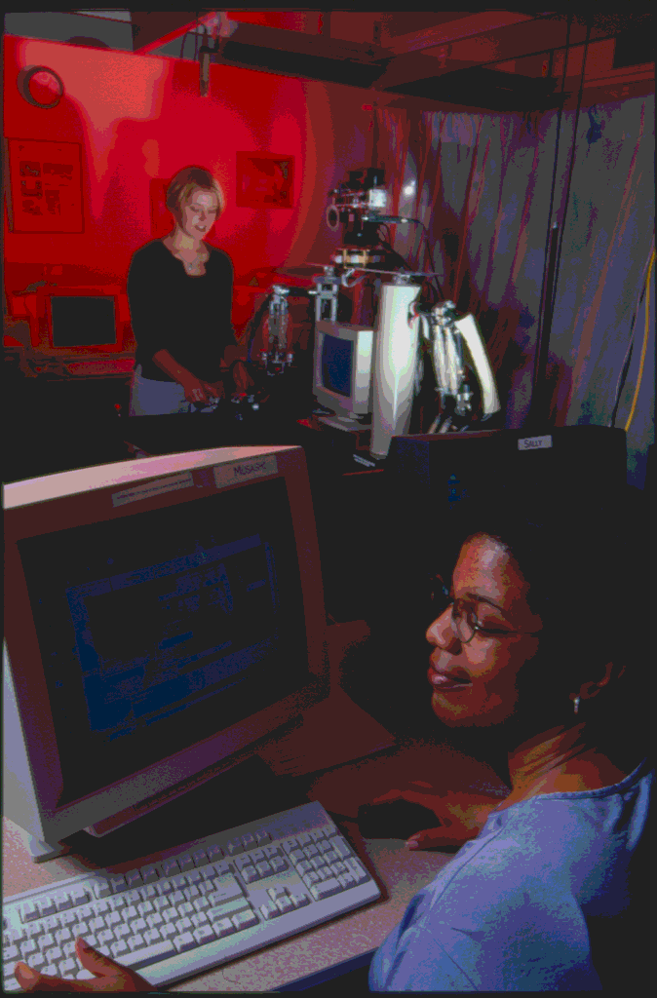
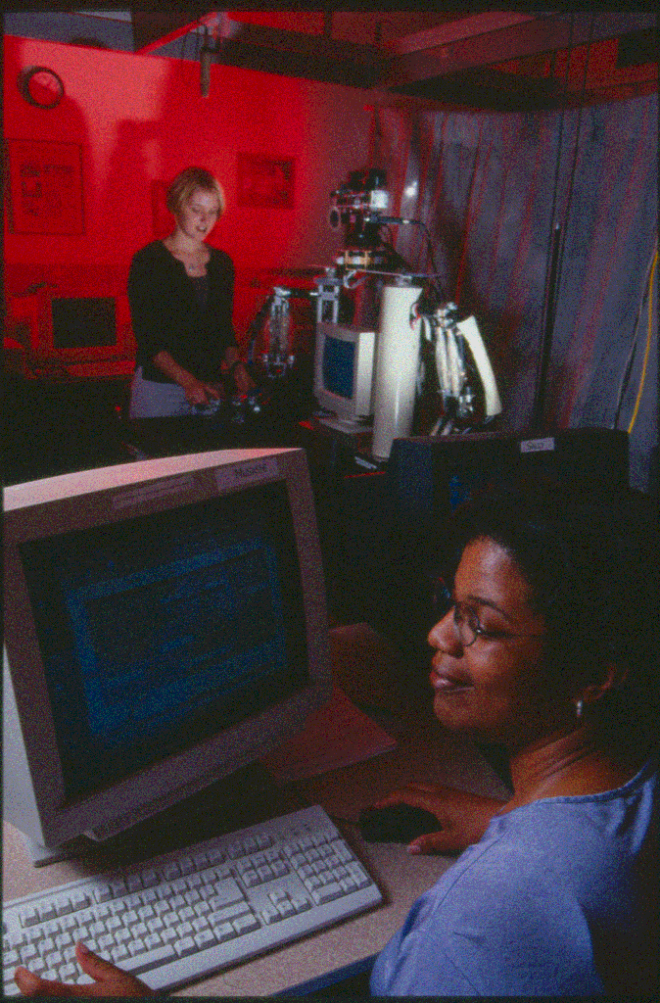
Dithering: use noise to reduce quant. error
8 bits
3 bits
3 bits + noise

Slide 52
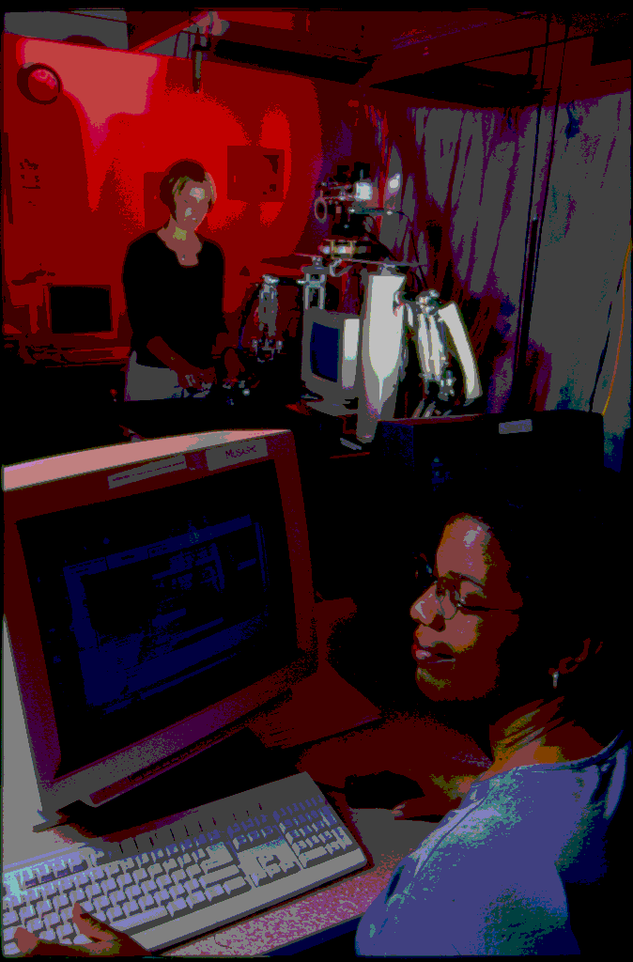
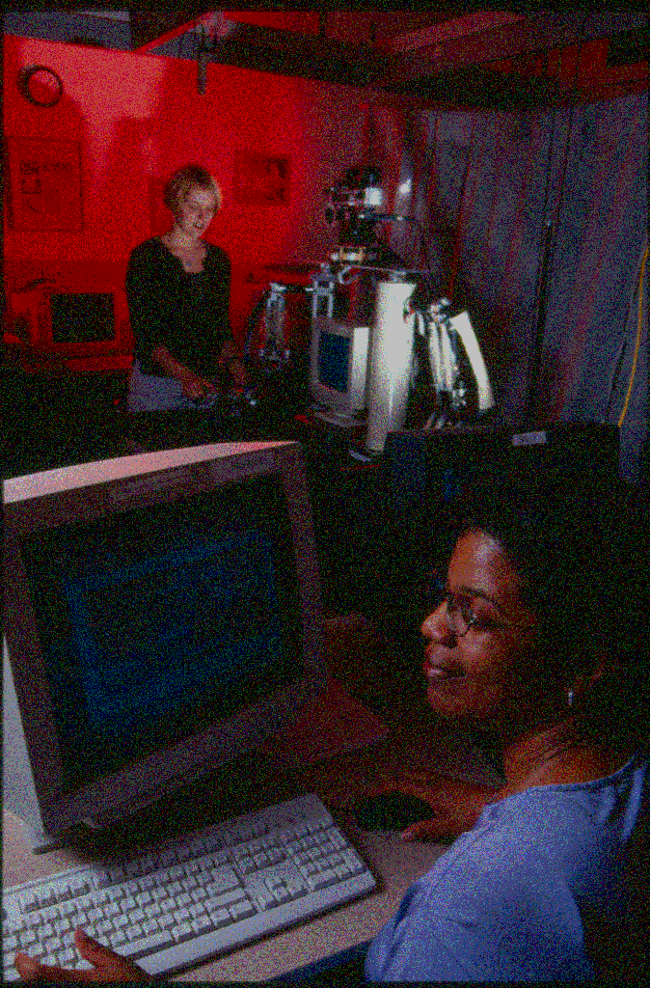
Dithering: use noise to reduce quant. error
8 bits
2 bits
2 bits + noise

Slide 53
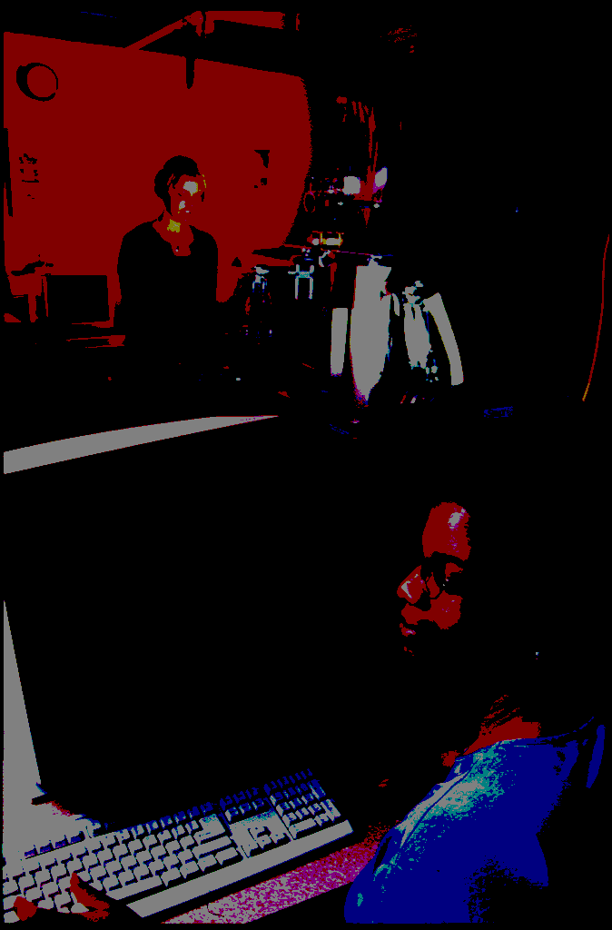
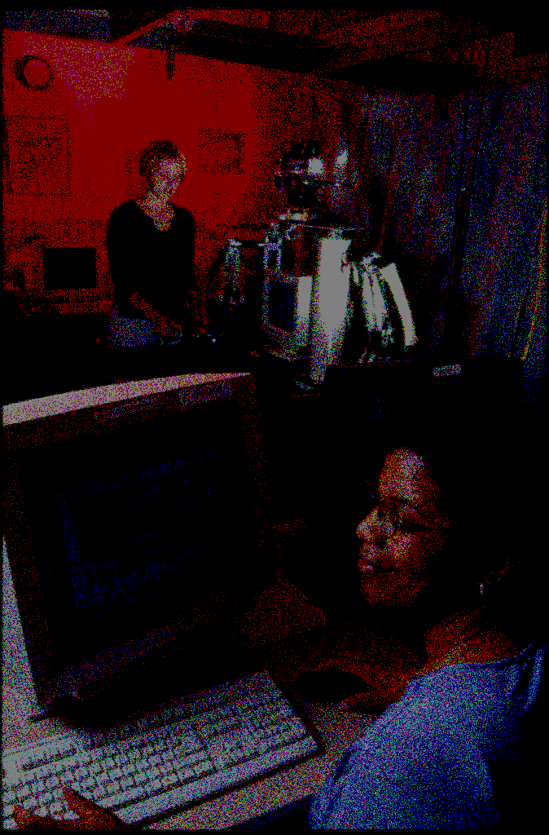
Dithering: use noise to reduce quant. error
8 bits
1 bit
1 bit + noise

Slide 54
Steganography

Slide 55
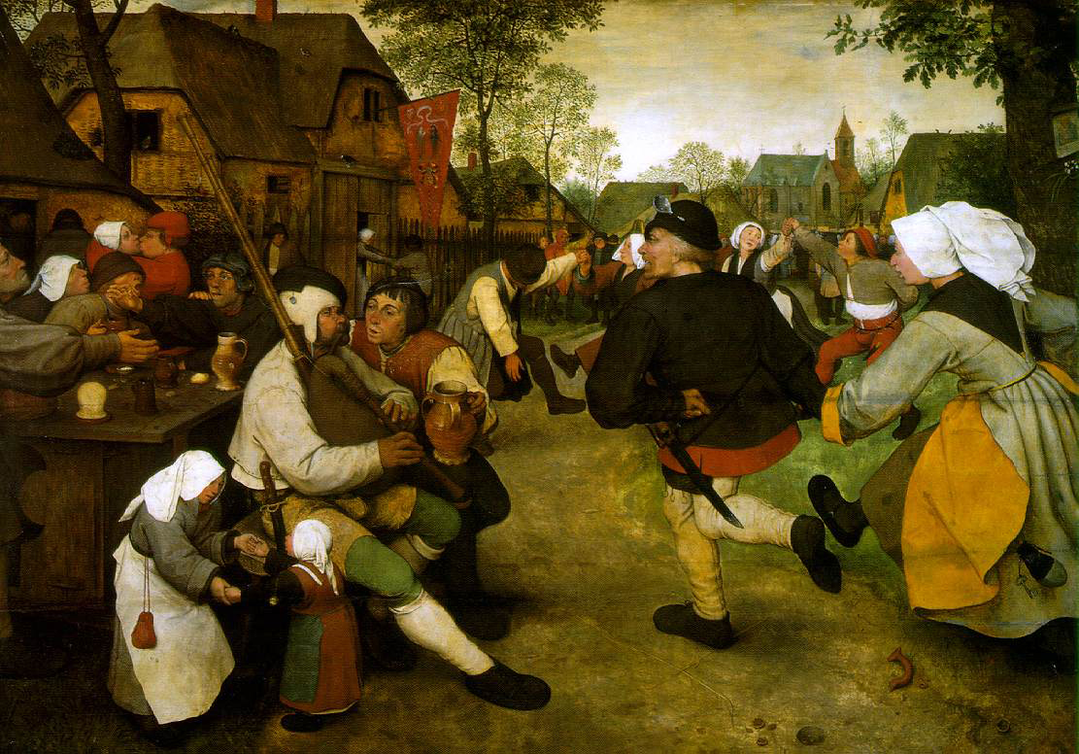
Application of Quantization: Steganography
8-bit-per-band, 3-band, “original” image
Pieter Bruegel (the Elder, ca. 1525-69), The Peasant Dance, 1568, Oil on oak panel, 114x164 cm, Kunsthistorisches Museum Wien, Vienna
If an image is quantized, say from 8 bits to 6 bits and redisplayed it can be all but impossible to tell the difference visually between the two.

Slide 56

Application of Quantization: Steganography
6-bit-per-band, 3-band, quantized image
Pieter Bruegel (the Elder, ca. 1525-69), The Peasant Dance, 1568, Oil on oak panel, 114x164 cm, Kunsthistorisches Museum Wien, Vienna
If an image is quantized, say from 8 bits to 6 bits and redisplayed it can be all but impossible to tell the difference visually between the two.

Slide 57
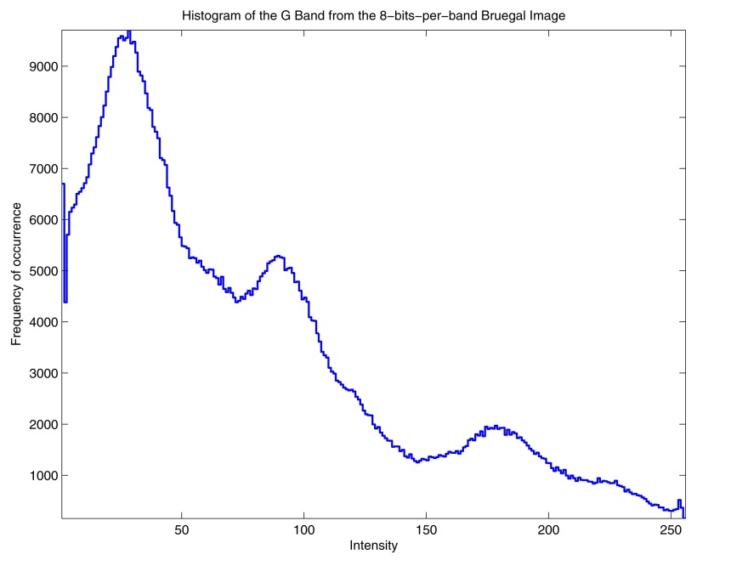

Application of Quantization: Steganography
green-band histogram of 8-bit image
green-band histogram of 6-bit image
With simple image analysis, it is easy to tell the difference: The histograms of the two versions indicate which is which. If the 6-bit version is displayed as an 8-bit image it has only pixels with values 0, 4, 8, … , 252.

Slide 58
Application of Quantization: Steganography
If the 6-bit version is displayed as an 8-bit image then the 8-bit pixels all have zeros in the lower 2 bits:
That other information could be a message, perhaps encrypted, or even another image.
Image 1
Image 2
b
b
b
b
b
b
0
0
R-Shift 2
R-Shift 6
b = 0 or 1
always 0
L-Shift 2
This introduces the possibility of encoding other information in the low-order bits.
logical OR
Image Out
X-Shift n = logical left or right shift by n bits.

Slide 59
Application of Quantization: Steganography
Image 1 in upper 6-bits. Image 2 in lower 2-bits.
Pieter Bruegel (the Elder, ca. 1525-69), The Peasant Dance, 1568, Oil on oak panel, 114x164 cm, Kunsthistorisches Museum Wien, Vienna
The second image is invisible because the value of each pixel is between 0 and 3. For any given pixel, its value is added to the to the collocated pixel in the first image that has a value from the set {0, 4, 8, … , 252}. The 2nd image is noise on the 1st.

Slide 60
Application of Quantization: Steganography
Image 1 in upper 6-bits. Image 2 in lower 2-bits.
Pieter Bruegel (the Elder, ca. 1525-69), The Peasant Dance, 1568, Oil on oak panel, 114x164 cm, Kunsthistorisches Museum Wien, Vienna
L-Shift 6
?
To recover the second image (which is 2 bits per pixel per band) simply left shift the combined image by 6 bits.

Slide 61

Application of Quantization: Steganography
Image 2 in upper 2-bits. Image 1 shifted out
L-Shift 6
From the video game, ZeroWing, by Toaplan. See http://en.wikipedia.org/wiki/All_your_base
image
To recover the second image (which is 2 bits per pixel per band) simply left shift the combined image by 6 bits.

Slide 62
Application of Quantization: Steganography
This is so effective that two 4-bit-per-pixel images can be superimposed with only the image in the high-order bits visible. Both images contain the same amount of information but because one takes on values between 0 and 15, the other takes on values from {16, 32, 48, … , 240}, and the smaller values are added to the larger, the image in the low-order bits is effectively invisible
Images 1 and 2 each have 4-bits per pixel when combined.
Image 1
Image 2
R-Shift 4
R-Shift 4
L-Shift 4
Image Out

Slide 63


Application of Quantization: Steganography
Original Image
Photo: CypherOne http://www.flickr.com/people/cypherone/

Slide 64

Application of Quantization: Steganography
Image quantized to 4-bits per pixel.
Photo: CypherOne http://www.flickr.com/people/cypherone/

Slide 65

Application of Quantization: Steganography
Image 1 in upper 4-bits. Image 2 in lower 4-bits.
Photo: CypherOne http://www.flickr.com/people/cypherone/

Slide 66

Application of Quantization: Steganography
Image 2 in upper 4-bits. Image 1 shifted out.
Phototographer Unknown

Slide 67


Histograms of Steganographs
Graffiti image: although the histogram of the 4-bit quantized image (right) has gaps of 16 between adjacent nonzero bins, its overall shape is similar to the original (left).

Slide 68


Histograms of Steganographs
Aspens image: again there are gaps of 16 between pixel values but the overall shape is preserved. Note the bell-shaped distribution. That is typical of natural scenes.

Slide 69


Histograms of Steganographs
Steganograph image: since the Aspens image’s values are “riding on top” of the Graffiti images values, Aspen’s pdf appears to be repeated at every nonzero bin of Graffiti.

